Slide 1
Introduction ASP
SureshM

Slide 2
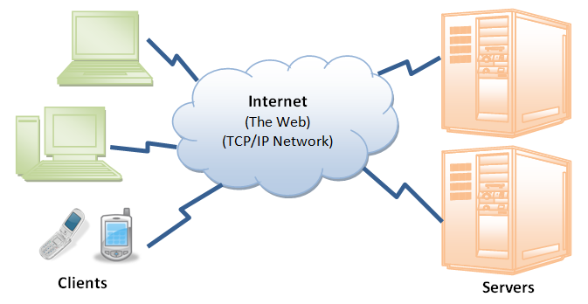
World Wide Web (WWW)
Many applications running
concurrently over the Web,
such as web browsing/surfing,
e-mail,
file transfer,
audio & video streaming,
In order for proper communication to take place between the client and the server, these applications must agree on a specific application-level protocol such as HTTP, FTP, SMTP, POP, and etc.
Notes:
The web is a two-tiered architecture.
A web browser displays information content,
and a web server transfers information to the client.
<number>

Slide 3
World Wide Web (WWW)
Web Browser :
An application for retrieving, presenting, and traversing information resources.
The primary purpose is to bring information resources to the user.
Web Server :
A computer program that accepts HTTP requests and return HTTP responses with optional data content.
WWW :
a way to let all users, but particularly scientists, browse each others’ papers on the Internet.

Slide 4
HTTP
HTTP is the protocol that enables us to buy microwave ovens from Amazon.com, reunite with an old friend in a Facebook chat, and watch funny cat videos on YouTube.
HTTP is the protocol behind the World Wide Web. It allows a web server from a datacenter in the United States to ship information to an Internet Café in Australia, where a young student can read a web page describing the Ming dynasty in China.
Notes:
A protocol is simply an agreed-upon method for initiating a communications session, passing information back and forth, and terminating the session.
(HTTP), used for Web page requests
Web requests piggyback on top of an underlying network protocol called Transmission Control Protocol/Internet Protocol (TCP/IP), which is a global communications
standard that determines the basic rules two computers follow to exchange information.
<number>

Slide 5
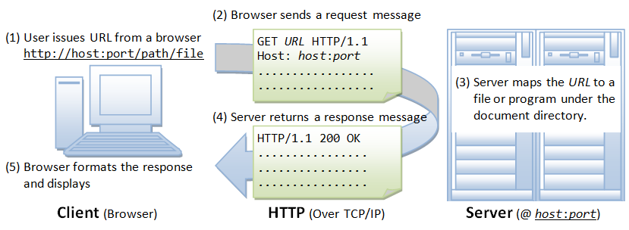
How HTTP works?
Notes:
We submitted URL (universal resource locator) in the URL bar and hits enter, Then our browser send HTTP requests to the web server for the web pages. Web server serves the HTTP request by convert that page in to appropriate form that our web browser can read and send the result via HTTP response.
A web browser, for example, may be the client and an application running on a computer hosting a web site may be the server.
The client submits an HTTP request message to the server. The server, which provides resources such as HTML files and other content, or performs other functions on behalf of the client, returns aresponse message to the client. The response contains completion status information about the request and may also contain requested content in its message body.
<number>

Slide 6
How HTTP works?
Whenever you issue a URL from your browser to get a web resource using HTTP, e.g. http://www.test101.com/index.html, the browser turns the URL into a request message and sends it to the HTTP server. The HTTP server interprets the request message, and returns you an appropriate response message, which is either the resource you requested or an error message.
Notes:
e.g. http://www.test101.com/index.html,
<number>

Slide 7
Uniform Resource Locator (URL)
A URL (Uniform Resource Locator) is used to uniquely identify a resource over the web. URL has the following syntax:
protocol://hostname:port/path-and-file-name
Protocol: The application-level protocol used by the client and server, e.g., HTTP, FTP, and telnet.
Hostname: The DNS domain name (e.g., www.test101.com) or IP address (e.g., 192.128.1.2) of the server.
Port: The TCP port number that the server is listening for incoming requests from the clients.
Path-and-file-name: The name and location of the requested resource, under the server document base directory.
Notes:
Uniform Resource Locator (URL)
<number>

Slide 8
Request and Response
HTTP is a request and response protocol.
A client sends an HTTP request message to a server using a carefully formatted message that the server will understand.
A server responds by sending an HTTP response message that the client will understand.
The request and the response are two different message types that are exchanged in a single HTTP transaction.
The HTTP standards (specification) define what goes into these request and response messages so that everyone who speaks "HTTP" will understand each other and be able to exchange resources (or respond with an error message when resources is not available).
Notes:
Imagine walking up to someone in an airport and asking "Do you know what time it is?". In order for the person to respond with the correct time, a few things have to be in place. First, the other person has to understand your question, because if they do not know English, they might not make any response. Secondly, the other person will need access to a watch or time keeping device.
This airport analogy is similar to how HTTP works. You need a resource from some other party (the resource being information about the time of day). So, you make a request to the other party using a language and vocabulary the other party might understand. If the other party understands your request and has the resource available, they can reply. If they understand the request, but they don't have the resource, they can still respond and tell you they can't help you. If they don't understand what you are saying, you might not get any response.
<number>

Slide 9
HTTP Request Message
The first line of the header is called the request line, followed by request headers.
syntax: request-method-name request-URI HTTP-version
request-method-name: HTTP protocol defines a set of request methods, e.g., GET, POST, HEAD, and OPTIONS. The client can use one of these methods to send a request to the server.
request-URI: specifies the resource requested.
HTTP-version: Two versions are currently in use: HTTP/1.0 and HTTP/1.1.
GET /test.html HTTP/1.1

Slide 10
Request Header
The request headers are in the form of name:value pairs. Multiple values, separated by commas, can be specified.
request-header-name: request-header-value1, request-header-value2, ...
Examples of request headers are:
Host: www.xyz.com
Connection: Keep-Alive
Accept: image/gif, image/jpeg, */*
Accept-Language: us-en, fr, cn

Slide 11
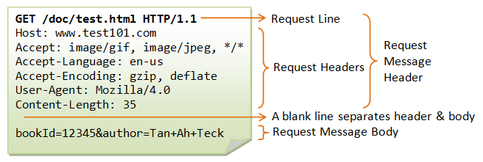
Request Message

Slide 12
HTTP Response Message
The status line has the following syntax:
HTTP-version status-code reason-phrase
HTTP-version: The HTTP version used in this session. Either HTTP/1.0 and HTTP/1.1.
status-code: a 3-digit number generated by the server to reflect the outcome of the request.
reason-phrase: gives a short explanation to the status code.
Common status code and reason phrase are "200 OK", "404 Not Found", "403 Forbidden", "500 Internal Server Error".
Examples of status line are:
HTTP/1.1 200 OK
HTTP/1.0 404 Not Found
HTTP/1.1 403 Forbidden

Slide 13
Response Headers
The response headers are in the form name:value pairs:
response-header-name: response-header-value1, response-header-value2, ...
Examples of response headers are:
Content-Type: text/html
Content-Length: 35
Connection: Keep-Alive
Keep-Alive: timeout=15, max=100
The response message body contains the resource data requested.

Slide 14
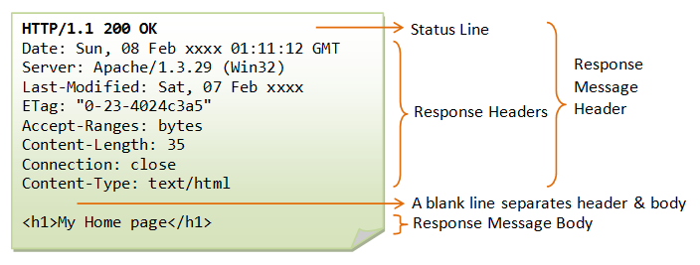
Response Message
Notes:
http://www.ntu.edu.sg/home/ehchua/programming/webprogramming/HTTP_Basics.html
<number>

Slide 15
Web Pages
WWW grew out of experiments in CERN, they build a way of transmitting information in a format (HTTP)
Markup language that is designed for simplicity with flexible structure (HTML)
HTML allowed text and graphics to be displayed in the browser
One thing that all these early pages lacked was any kind of dynamic content
Notes:
great strength of HTML and HTTP, besides universality, the document can contain information about the meaning of the content, and the way that the writer intended it to be perceived.
Markup language is simply a series of elements, each delimited with special characters, that define how text or other items enclosed within the elements should be displayed
HTML 4.0 From these simple beginnings, extra features were added to build version 4.0 of HTML that we use today that provided for more flexible text styling and more control over the final layout of the page
This wasn't a problem at the time, because the reason for the development of HTML was to display and transmit information (particularly technical and scientific information) between disparate computers, networks and operating systems.
The standardization of documents as just simple text and markup, with images or other non-text content in separate files, meant that they could be freely transmitted across any kind of network.
because the format of the information was fixed and the 'meaning' of each element was defined in HTML, it was relatively easy to implement a 'reader' or browser application in any programming language, on any platform or operating system.
As far as serving up these pages of information, text files and graphics can be delivered to the user by a Web Server application, which simply reads them from disk and converts the output to the correct HTTP protocol for transmission across the network. At the client or user end, the browser takes the incoming stream and converts it into a page that can be displayed.
<number>

Slide 16
Static Page
"Static" means unchanged or constant. Web pages contain the same prebuilt content each time the page is loaded,
Standard HTML pages are static Web pages. They contain HTML code, which defines the structure and content of the Web page. Each time an HTML page is loaded, it looks the same. The only way the content of an HTML page will change is if the Web developer updates and publishes the file.
Notes:
Web pages can be either static or dynamic.
<number>

Slide 17
Dynamic page
“Dynamic" means changing or lively and the content of dynamic Web pages can be generated on-the-fly.
Web pages, such as PHP, ASP, and JSP pages are dynamic Web pages. These pages contain "server-side" code, which allows the server to generate unique content each time the page is loaded.
Use of server-side code to access database information, which enables the page's content to be generated from information stored in the database.

Slide 18
Why Dynamic Page needed?
new types of document content <INPUT> that allow users to enter information made it necessary to develop applications that could read and make use of this information .
delivering content extracted from another application, especially a database required a new approach
Notes:
<number>

Slide 19
How to make pages Dynamic?
it became normal practice for the Web server to expose an interface that other applications could connect to.
Through this interface, custom executable applications could receive the information sent from the client, including details of the page request
The application could then create a response to the client internally, rather than reading a text and markup file from the server's disk.
Notes:
<number>

Slide 20
CGI
The interface used for these applications is called the Common Gateway Interface
(CGI) – a standard that can be implemented in any language including C
Early applications were compiled programs written in C|++
recompile an executable each time you wanted to make a minor change to the text or markup that it created, were limiting the use of the CGI and dynamic pages
Notes:
This specification allowed resources, in the form of executable programs, to be requested by a web browser and executed by a web server via a standard Uniform Resource Locator or URL.
These CGI-based programs could take user input in the form of command line parameters and use the standard input and output file handles of a program to receive and generate HTML output in response to a browser’s request. In addition, various pieces of state information located on the server could be interrogated by the program during execution and used to make logic decisions as to how this processing should occur. The ultimate goal: use this logic and processing capability to provide a custom experience for the user on the other side of the browser.
In one way or another, what emerged was a means of using logic far beyond the capabilities of HTML to accomplish standard data processing functionality such as input validation and database access and the power to distribute that processing across the world.
cgi-bin (the 'bin' part meaning binary code rather than text). Early applications were actually compiled programs, usually written in C or C++. However, it became plain that having to know about C programming, and recompile an executable each time you wanted to make a minor change to the text or markup that it created, were limiting the use of the CGI and dynamic pages.
<number>

Slide 21
CGI
A new way of creating the page using a scripting language was developed that is called PERL.
It allows information creators to write code in a language rather like a simplified version of C or C++.
Within the Perl script, you 'write' the text and markup output to be sent to the browser using the stdin and stdout functions that communicate with the Web server via the CGI.
still a popular language on the Web, especially in Unix- or Linux-based systems
isn't easy to get to grips with, especially for Web developers who have no prior knowledge of C or C++.
Notes:
Instead, a way of creating the page using a scripting language was developed. This language is the Practical Extraction and Reporting Language, or Perl as it's better known, and it allows information creators to write code in a language rather like a simplified version of C or C++. Within the Perl script, you 'write' the text and markup output to be sent to the browser using the stdin and stdout ('standard in' and 'standard out') functions that communicate with the Web server via the CGI.
http://computer.howstuffworks.com/cgi3.htm
<number>

Slide 22
CGI Specification
In the normal directory tree that the server considers to be the root, you create a subdirectory named cgi-bin.
server understands that any file requested from the special directory should not simply be read and sent, but instead should be executed
The output of the executed program is what it actually sent to the browser that requested the page.
The executable is generally either a pure executable, like the output of a C compiler, or it is a PERL script.
Notes:
type following URL into your browser:http://www.deerwalk.com.com/cgi-bin/search.pl. The server recognized that search.pl is in the cgi-bin directory, so it executes search.pl (which is a PERL script) and sends the output from the execution to your browser.
<number>

Slide 23
Server side scripting
For a script to work with a Web server there needs to be some kind of intermediate application
To handle the communication to and from the Web server (generally via the CGI)
To interpret and execute the appropriate server-based script then create the output page and communicate it to the Web server

Slide 24
Active Server Pages
Introduced with release of Microsoft’s web server, Internet Information Server or IIS.
Actually a series of dynamic link libraries or DLL's that are installed on your web server that has the ability to interpret and process information via the use of a script file (called an ASP script) that is resident in your web application directory.
Natural way to build dynamic Web pages, entire sites, and Web-based applications on a Windows server platform.

Slide 25
Active Server Pages
Active Server Pages is an open, compile-free application environment in which you can combine HTML, scripts, and reusable ActiveX server components to create dynamic and powerful Web-based business solutions.
Active Server Pages enables server side scripting for IIS with native support for both VBScript and JScript.

Slide 26
Active Server Pages
Once you complete the installation of Active Server Pages, a web browser can request scripts just as if it were requesting an HTML file.
The difference is these files contain Active Server Page script, usually in the form of VBSCRIPT or JSCRIPT, and have a file extension of .ASP.
When requested, these scripts execute in the Active Server Page environment instead of being simply returned to the browser and produce output for sending back to the requesting browser.

Slide 27
Installing ISS & run Active Server Pages
Go to add remove windows components or windows feature
In the Wizard window check Internet Information Services, click OK
An Inetpub folder will be created on your harddrive consisting wwwroot folder
Create a new folder, like "MyWeb", under wwwroot.
Use a text editor to write some ASP code, save the file as "test1.asp" in the "MyWeb" folder
Make sure your Web server is running – if not press the Start button
Open your browser and type in "http://localhost/MyWeb/test1.asp", to view your first ASP page

Slide 28
Installing ISS & run Active Server Pages
A virtual directory is a directory name (also referred to as path) that you specify in IIS and map to a physical directory on a local or remote server. The directory name then becomes part of the application's URL, and users can request the URL from a browser to access content in the physical directory, such as a Web page or a list of additional directories and files.
A virtual directory appears to browsers as if it were contained in a Web server's root directory, even though it can physically reside somewhere else. This approach enables you to publish Web content that is not located under the root folder of a Web server, such as content that is located on a remote computer.

Slide 29
Benefit and application of ASP
Dynamically edit, change or add any content of a Web page
Respond to user queries or data submitted from HTML forms
Access any data or databases and return the results to a browser
Customize a Web page to make it more useful for individual users
Provides security since your ASP code can not be viewed from the browser
Since ASP files are returned as plain HTML, they can be viewed in any browser

Slide 30
<%@ LANGUAGE="VBSCRIPT" %>
<HTML> <HEAD> <TITLE>My First ASP Script!</TITLE> </HEAD> <BODY>
<% for x = 3 to 6 %> <FONT SIZE=<% =x %>>Hello ASP World!</FONT><BR> <% next %>
</BODY> </HTML>

